Slide 1

UEEN 3113 / 3413
Server Configuration and management

Slide 2
Categories
Linux
Unix / Unix-based
Windows server

Slide 3
Linux
Linux is a clone of the Unix operating system, written from scratch, distributed under the GNU General Public License v2.
GNU GPL is the most widely used free software license and has a strong copyleft requirement. When distributing derived works, the source code of the work must be made available under the same license. Different variants of GNU GPL with different requirements.
Able to run on various hardware platforms.
Notes:
* From Linux Readme

Slide 4
Linux
The core: Linux kernel
By the kernel version: latest stable version is 4.14.14 (14/1/2018)
https://www.kernel.org
Github of the creator, Linus Torvalds: https://github.com/torvalds/linux

Slide 5
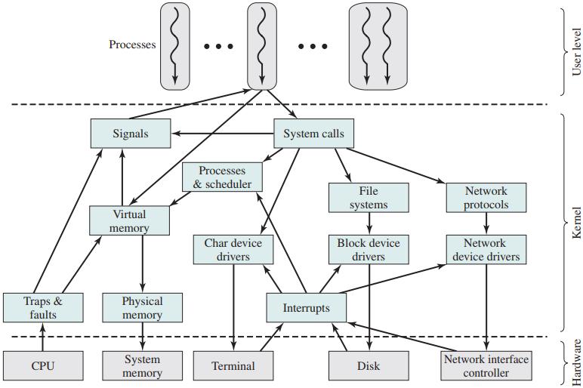
Linux
Kernel components

Slide 6
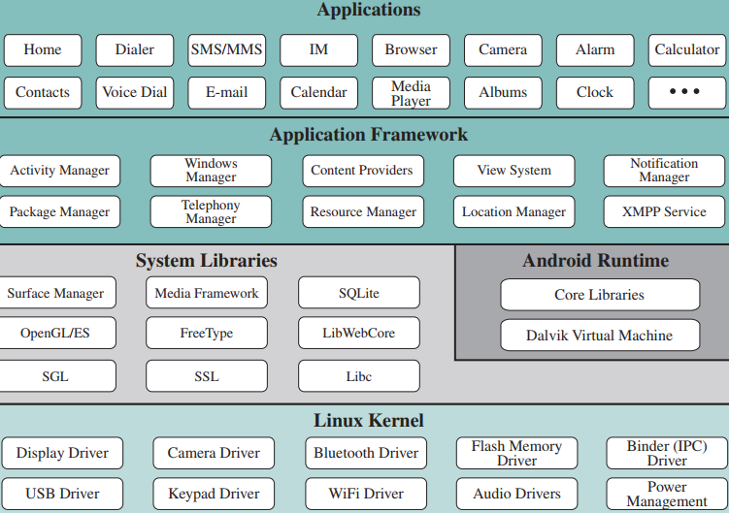
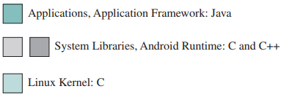
Linux
Android software architecture

Slide 7
Linux
File system
Ext4
Journaling file system evolved from ext3 file system.
Reduce file fragmentation, support larger volumes and files, improve flash memory life by delayed allocation.
Default file system for many distributions.
Backwards compatible – can mount as ext3, or mount ext2 / ext3 as ext4.

Slide 8
Linux
File system
BtrFS (B-Tree File System), designed by Oracle for Linux
Enable drive pooling, on the fly snapshots, transparent compression, and online defragmentation.
The maintainer of ext4 file system stated that BtrFS is a better direction because of its scalability, reliability, and ease of management.

Slide 9
Linux
File system
XFS - developed by Silicon Graphics for SGI IRX OS
It uses delayed allocation.
Can be enlarged on the fly but not shrunk.
Good performance in handling large files.
JFS (Journaled File System) – developed by IBM for AIX OS
Good performance for large and small files.
Can be enlarged dynamically but not shrunk.

Slide 10
Linux
File system
Swap – special type for virtual memory
exFAT – ideal file system for storage device that is to be used in Linux, Windows and Mac OS.

Slide 11
Linux
Package Manager
dpkg (Debian Package Management System)
For Debian Linux or Debian-based Linux like Ubuntu.
Front-end tools for dpkg: APT (Advanced Packaging Tool), Aptitude, Synaptic Package Manager, Ubuntu Software Centre
RPM (Red Hat Package Manager)
Created by Red Hat, used in RedHat Enterprise Linux or RedHat Linux-fork such as Fedora and CentOS
Front-end tools: YUM (Yellowdog Updater, Modified), DNF – Dandified Yum, YaST, Zypper, etc.

Slide 12
Linux
Directories
/bin - contains essential user command binaries for all users
/boot - contains static files of the boot loader
/dev - contains device files for all the devices in the Linux file system
/etc - holds configuration files, many are shell scripts
/home - default location which contains user directories
/lib - contains essential shared libraries and kernel modules
/media - mount point for removable media
/mnt - contains temporarily mounted filesystem. E.g. NFS

Slide 13
Linux
Directories
/opt - reserved for the installation of add-on application software packages.
/root - the Linux superuser or root user's home directory.
/run - contains system information data since the system was booted. Cleared at beginning of the boot process.
/sbin - contains additional binary executable programs normally used by root user.
/srv - contains data for services provided by the system.
/tmp - used for temporary file and directory storage.

Slide 14
Linux
Directories
/usr - contains other subdirectories for applications, such as X11, library files, header files, etc.
/var - contains both files and directories; log files for various processes located in /var/log. The system log file located in /var/log/messages.
/boot and /home usually can be located in separated partitions instead of in /.

Slide 15
Linux
Storage – RAID (Redundant Array of Independent Disks)
combines multiple disks into one/more logical units for data redundancy and/or performance improvement.
7 levels of RAID, can be categorised into 4 categories.
Category | RAID level
Stripping | 0
Mirroring | 1
Parallel access | 2, 3
Independent access | 4, 5, 6

Slide 16
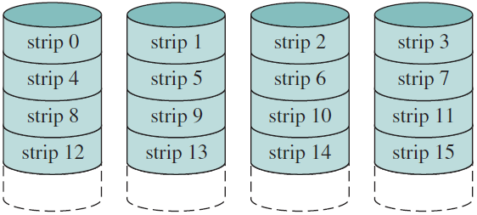
Linux
RAID 0 (minimum 2 disks)
Does not include redundancy to improve performance or provide data protection – not a true RAID family member.
Data are stripped across all the disks in the array.
Two I/O requests can be served in parallel in the requested blocks of data are located on different disks (different strips).
Strips are mapped physical disks in round robin style.
Stripe

Slide 17
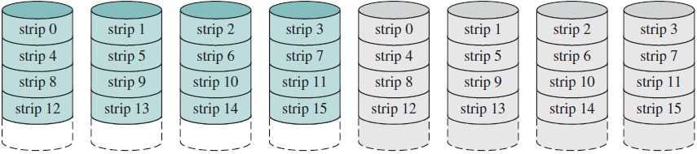
Linux
RAID 1 (minimum 2 disks)
Redundancy is achieved by simple expedient of duplicating all the data. (Levels 2 through 6 use parity calculation to achieve redundancy)
Each logical strip is mapped to two separate physical disks so that every disk in the array has a mirror disk that contains the same data.

Slide 18
Linux
RAID 1 - impacts of disk mirroring
A read request can be serviced by either of the 2 disks, whichever one involves the minimum seek time plus rotational latency.
A write request requires both corresponding strips be updated, but this can be done in parallel.
Failure recovery is simple: when a drive fails, the data may still be accessed from the second drive.
Disadvantage: costly as requires twice the disk space

Slide 19
Linux
RAID 2
Strips are often as small as a single byte or word.
All disks participate in the execution of every I/O request
Disks are synchronised so that each disk head is in the same position on each disk at any given time.
An error-correcting code (typically Hamming code) is calculated across corresponding bits on each disk, and the bits of the code are stored in the corresponding bit positions on multiple parity disks.

Slide 20
Linux
RAID 2
On a read, all disks are simultaneously accessed, requested data and the associated error-correcting code are delivered to the array controller.
If there is a single-bit error, the controller can recognise and correct it instantly.
On a write, all data disks and parity disks must be accessed for the write operation.
Effective choice in an environment with many disk errors.
Minimum 3 disks.

Slide 21
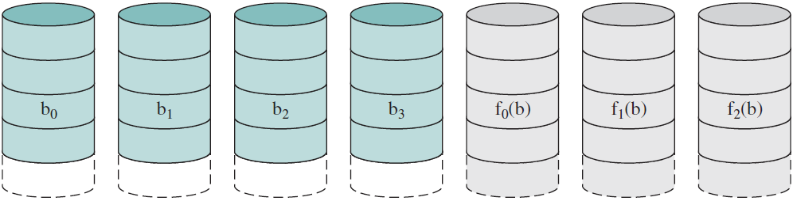
Linux
RAID 2
Parity disks to store error correction codes

Slide 22
Linux
RAID 3
Similar to RAID 2 but requires only a single parity disk.
Data are distributed in small strips, can achieve very high transfer rate but ONLY ONE I/O request can executed at a time.
Not suitable for transaction-oriented environment.
A parity bit is computed for the set of individual bits in the same position on all of the data disks.
Enable data to be reconstructed from the remaining disks.
Minimum 3 disks.

Slide 23
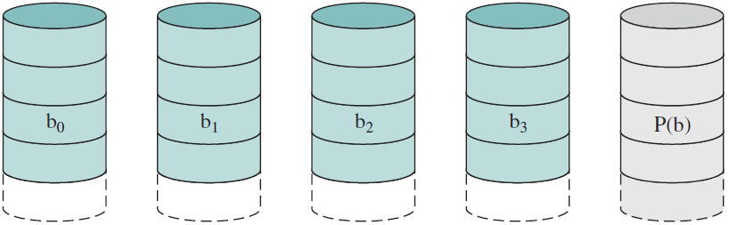
Linux
RAID 3
Calculation for parity for the i-th bit
X₄(i) = X₃(i) ⊕ X₂(i) ⊕ X₁(i) ⊕ X₀(i)
⊕ is exclusive-OR function
X₀
X₁
X₂
X₃
X₄

Slide 24
Linux
RAID 3
Suppose that X₁ failed, to reconstruct data, add X₄(i) ⊕ X₁(i) to both sides of the equation in the preceding slide:
X₁(i) = X₄(i) ⊕ X₃(i) ⊕ X₂(i) ⊕ X₀(i)
This is applicable to RAID 3 to RAID 6
X₀
X₁
X₂
X₃
X₄

Slide 25
Linux
RAID 4
Each member disk operates independently
Separate I/O requests can be satisfied in parallel.
Suitable for high I/O request rates applications.
Bit-by-bit parity strip is calculated across corresponding strips on each data disk, and stored in the corresponding strip on the parity disk.
On a write, both data and corresponding parity bits must be updated by the array management software – a write penalty for small size writing request.

Slide 26
Linux
RAID 4
Initial bit calculation: X₄(i) = X₃(i) ⊕ X₂(i) ⊕ X₁(i) ⊕ X₀(i) ---C1
Suppose that a strip on disk X₁ is updated, bits potentially changed (indicated by prime symbol)
X₄’(i) = X₃(i) ⊕ X₂(i) ⊕ X₁’(i) ⊕ X₀(i) ------C2
X₄’(i) = X₃(i) ⊕ X₂(i) ⊕ X₁’(i) ⊕ X₀(i) ⊕ X₁(i) ⊕ X₁(i) ------C3
X₄’(i) = X₃(i) ⊕ X₂(i) ⊕ X₁(i) ⊕ X₀(i) ⊕ X₁(i) ⊕ X₁’(i) ------C4
Replace first 4 terms in C4 with C1
X₄’(i) = X₄(i) ⊕ X₁(i) ⊕ X₁’(i)

Slide 27
Linux
RAID 4
C2 shows that a change in X₁ will affect the parity disk X₄.
In C3, [X₁(i) ⊕ X₁(i)], which is 0, is added to C2 in order to produce C4 by reordering the terms.
Finally, replace the first 4 terms with C1 to obtain the final equation for new parity.
Must read old user strip and old parity strip to calculate new parity, then update them with new data and new parity – requires 2 reads and 2 writes.

Slide 28
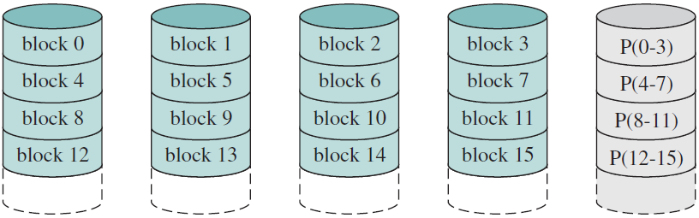
Linux
RAID 4
If a write involves strips on all disks, then the new parity can be calculated easily by using all new data bits.
Every write involves parity disk which might become a bottleneck.
Minimum 3 disks.

Slide 29
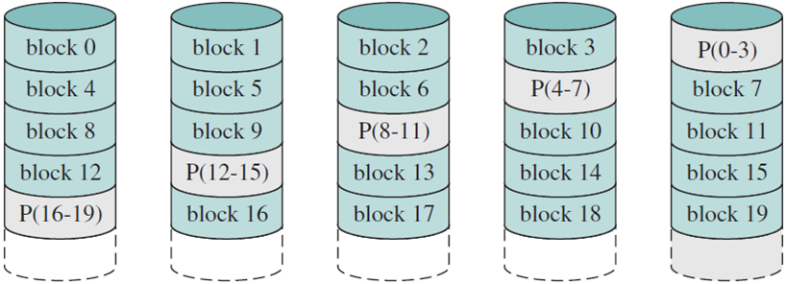
Linux
RAID 5 (minimum 3 disks)
Similar to RAID 4 but the parity strips are distributed across all disks, typically using round robin scheme.
For n-disk array, the parity strip is on a different disk for the first n stripes, and the pattern then repeats. Avoid bottleneck.
Stripe

Slide 30
Linux
RAID 6
Uses 2 different parity calculations and stores the parity in separate blocks on different disks.
One of the calculations is the exclusive-OR (used in RAID 4 & 5).
The other is an independent data check algorithm.
Possible to regenerate data even if two data disks failed.
N disks user data array consists of N+2 disks.
Incur write penalty as a write affects 2 parity blocks.

Slide 31
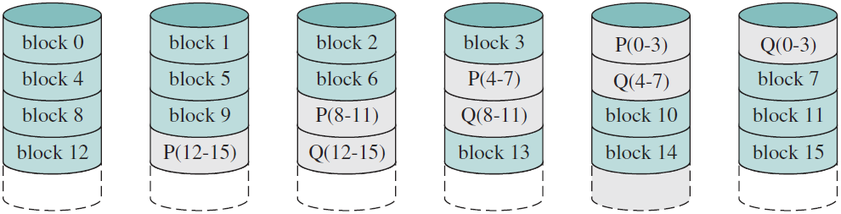
Linux
RAID 6

Slide 32

Linux
Nested / hybrid RAID: RAID 10 or RAID 1+0
Is a stripe of mirrors.
Suitable for database, email and web server which require high disk performance.
Minimum 4 disks.
RAID 0
RAID 1
RAID 1
RAID 1
RAID 1

Slide 33
Linux
Shell
SH (Bourne Shell) – original UNIX shell
BASH (Bourne Again Shell) – most commonly used
CSH (C Shell) – syntax and usage are very similar to the C programming language
KSH (Korn Shell) – features built-in arithmetic evaluation and advanced scripting capabilities
To check for available shell: cat /etc/shells

Slide 34
Linux
You may want to look at Linux distributions at https://www.distrowatch.com

Slide 35
Unix
AT&T: Unix System V
Berkeley Software Distribution: BSD Unix
Other variants
IBM AIX
Hewlett-Packard's HP-UX
Sun's Solaris
FreeBSD
OpenBSD
…

Slide 36
Microsoft Windows Server
Windows NT Server (3.5, 3.5.1, 4.0)
Windows 2000 Server
Windows Server 2003, 2003 R2
Windows Server 2008, 2008 R2
Windows Server 2012, 2012 R2
Windows Server 2016

Slide 37


